Slide 1

Credit Case Study Using Python
Akash Pandey

Slide 2
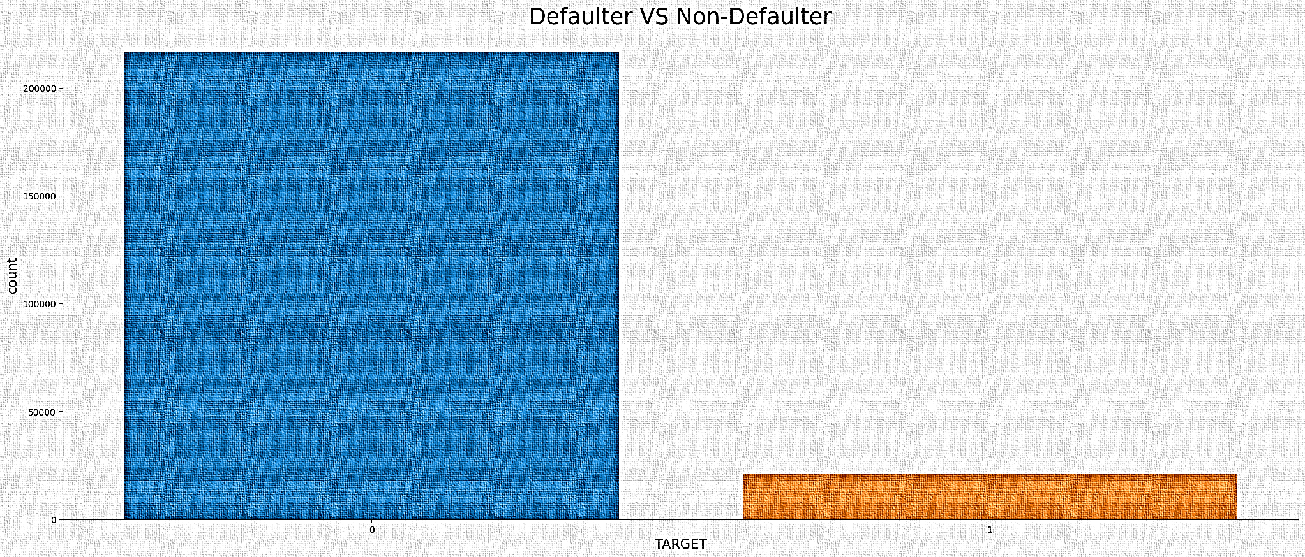
As per Graph number of who not pays on time is very less than who pays on time.
Akash Pandey

Slide 3
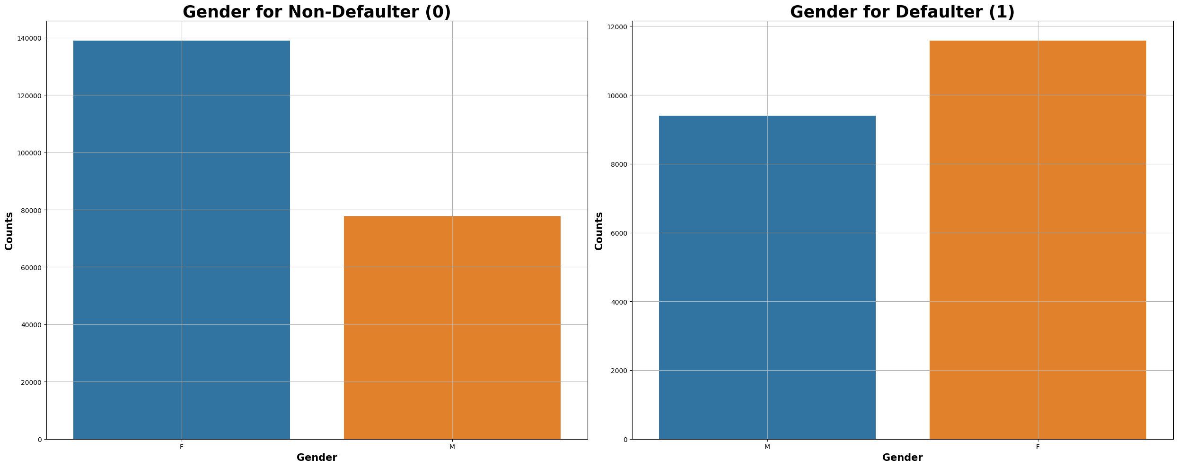
Female number is greater than Male number in loan defaulter and Non-Defaulter.
Akash Pandey

Slide 4
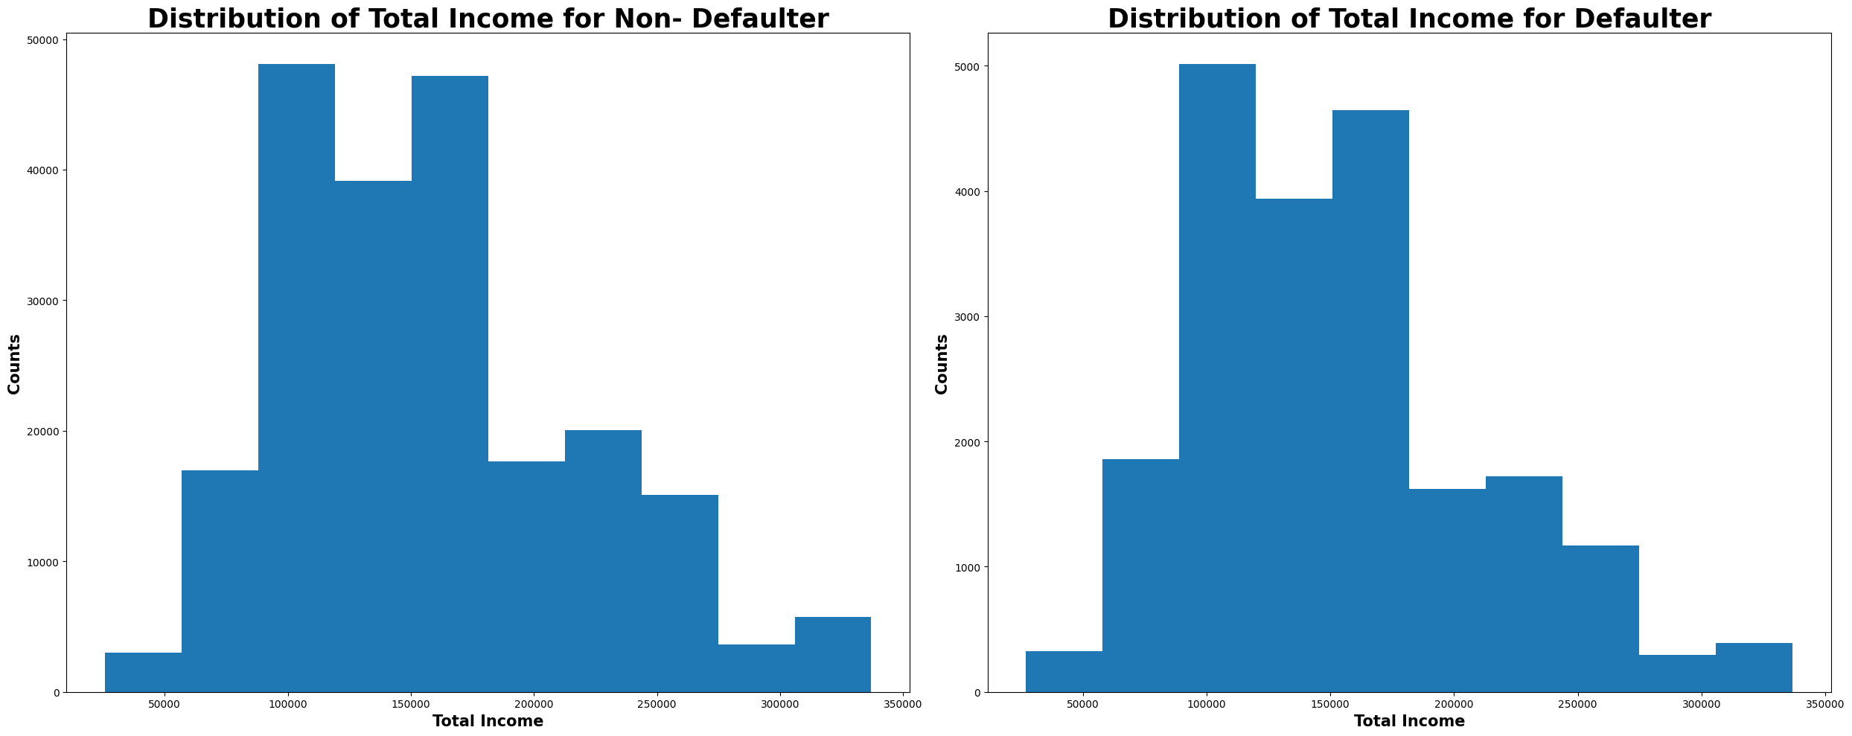
Approx. Applicant has income between 0.5 – 2.5 Lakh for loan defaulter and Non-Defaulter.
Akash Pandey

Slide 5
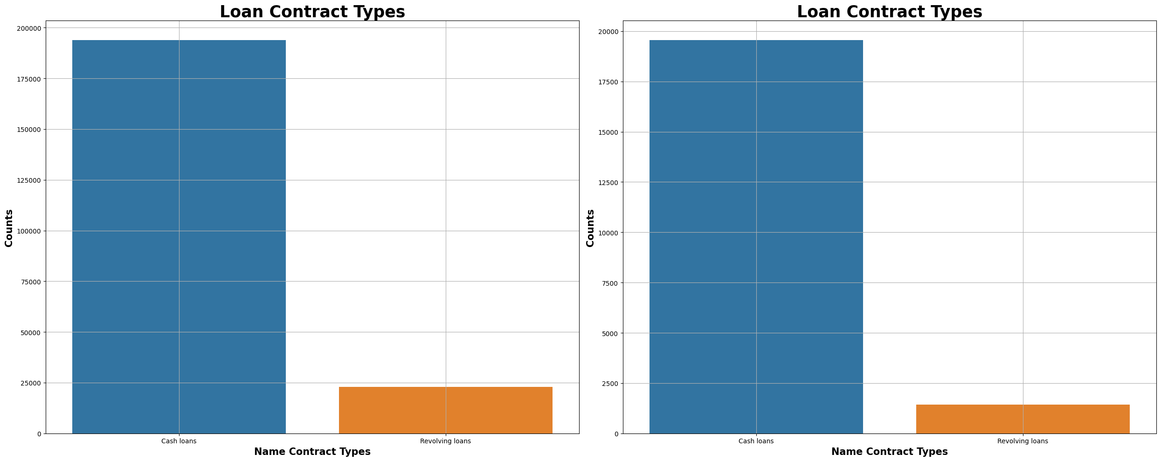
Cash loan number is greater than other Contract type for loan defaulter and Non-Defaulter.
Akash Pandey

Slide 6
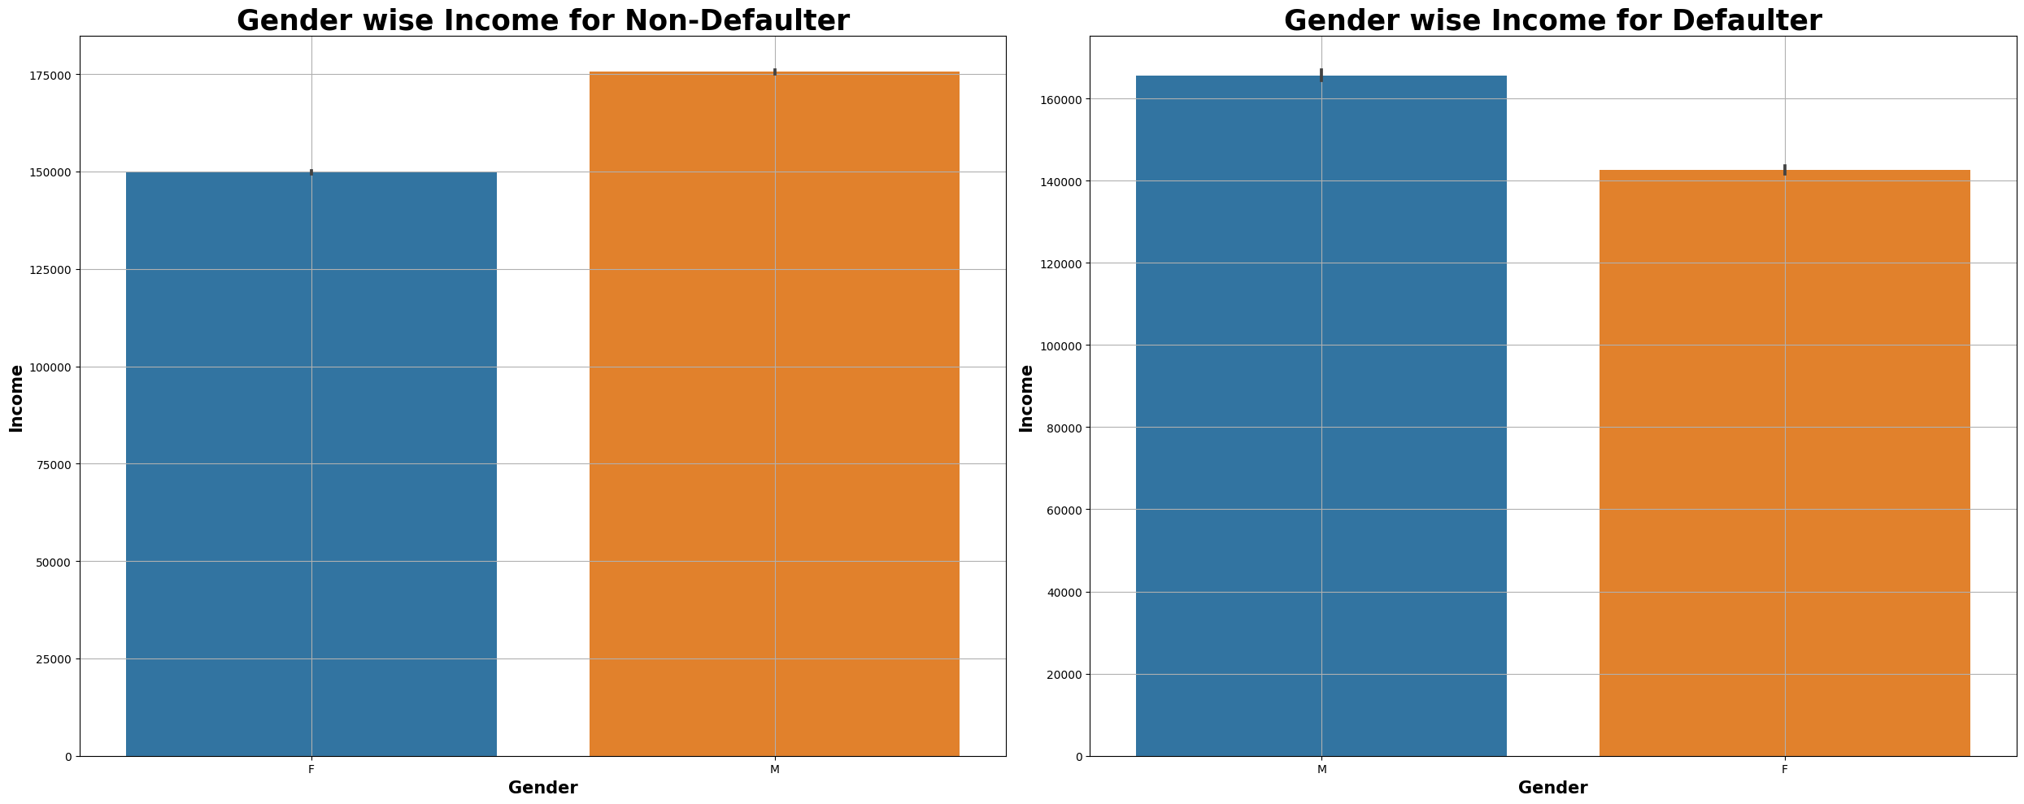
Male Number is greater than Female number in high Income earning for loan defaulter and Non-Defaulter.
Akash Pandey

Slide 7
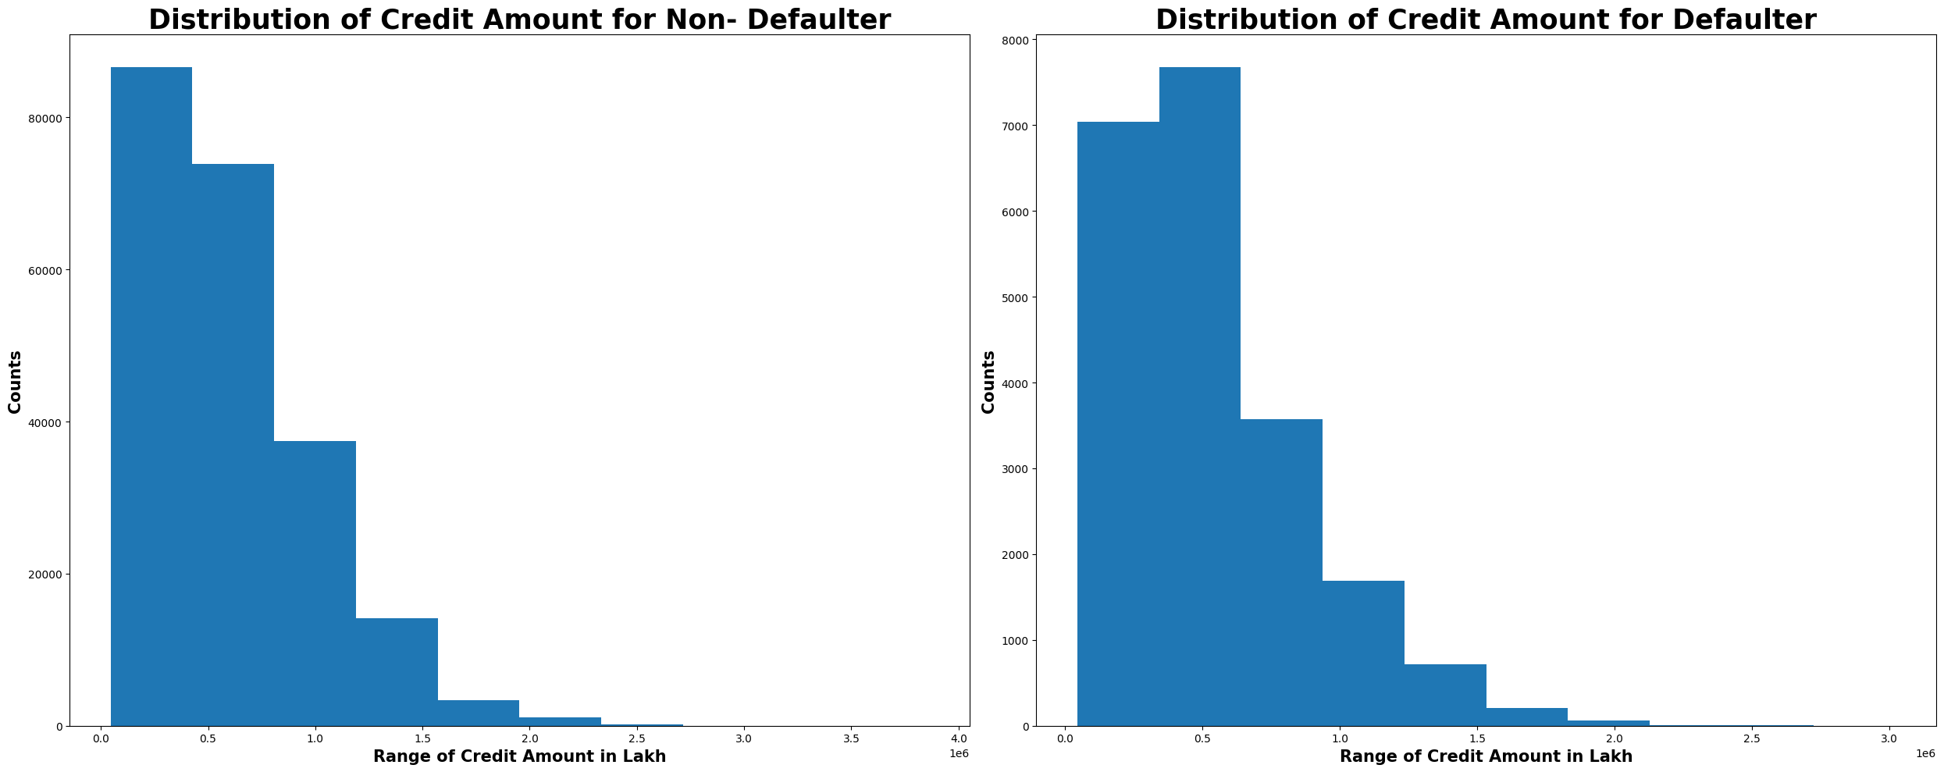
Akash Pandey

Slide 8
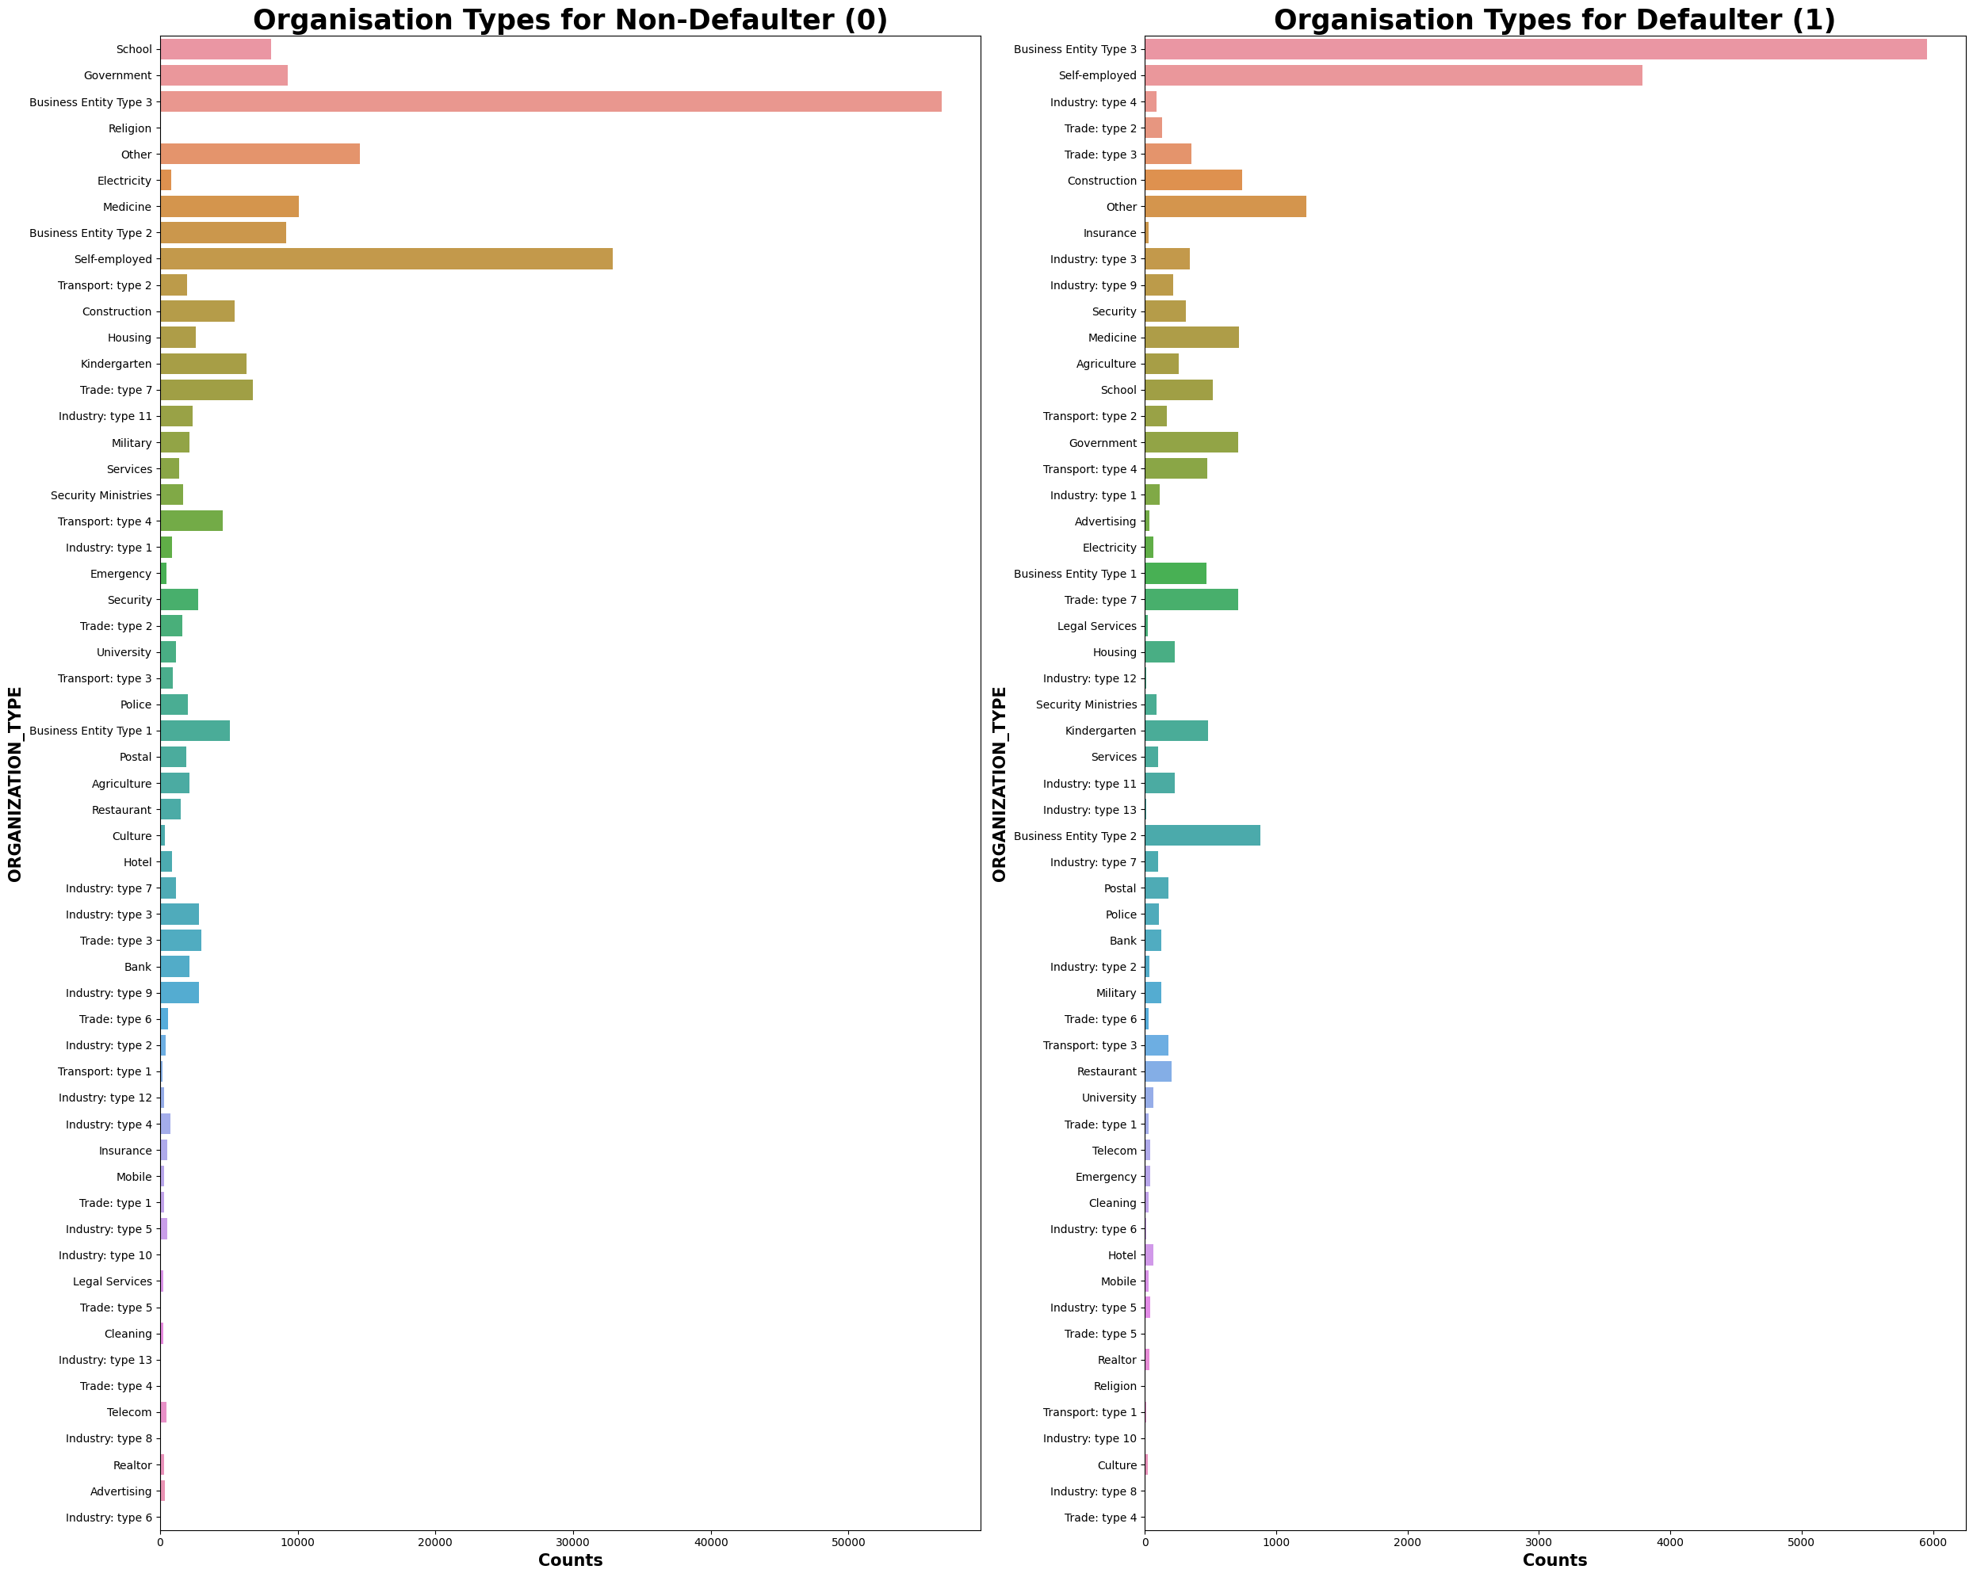
Akash Pandey

Slide 9
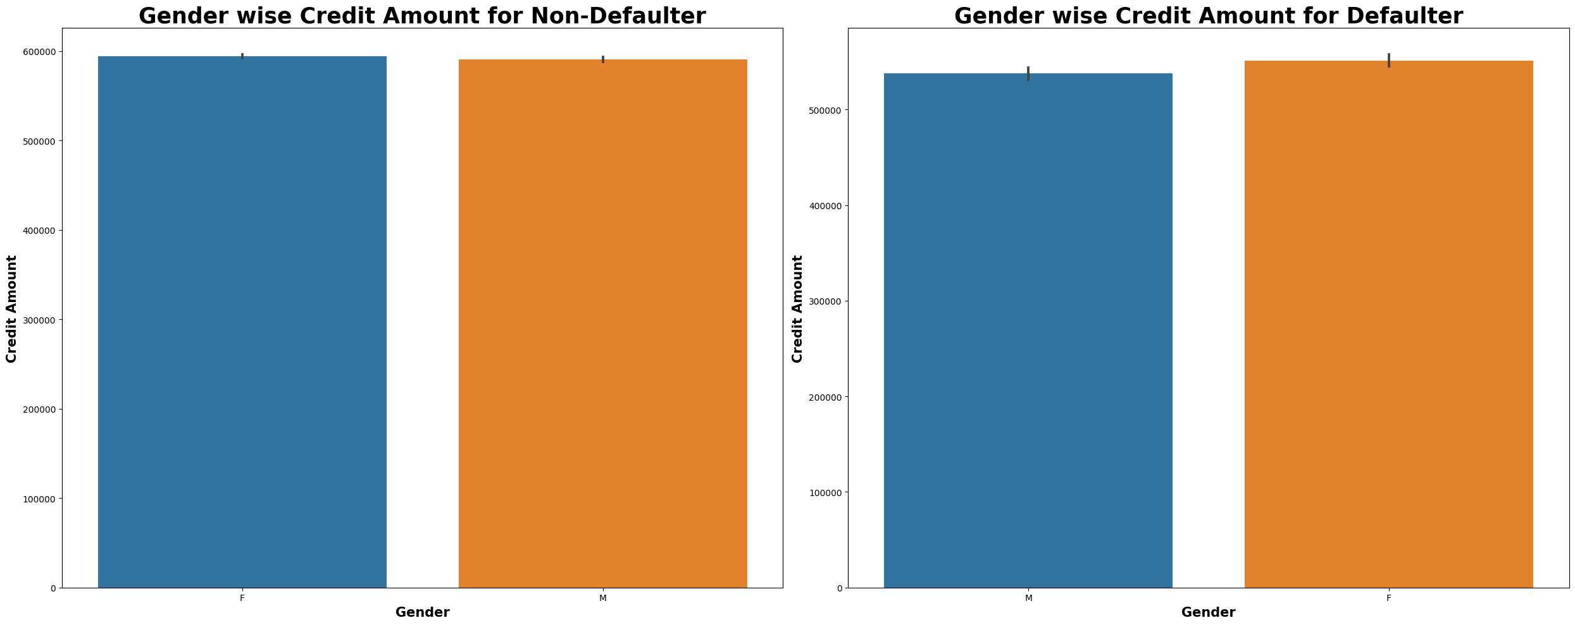
Akash Pandey

Slide 10
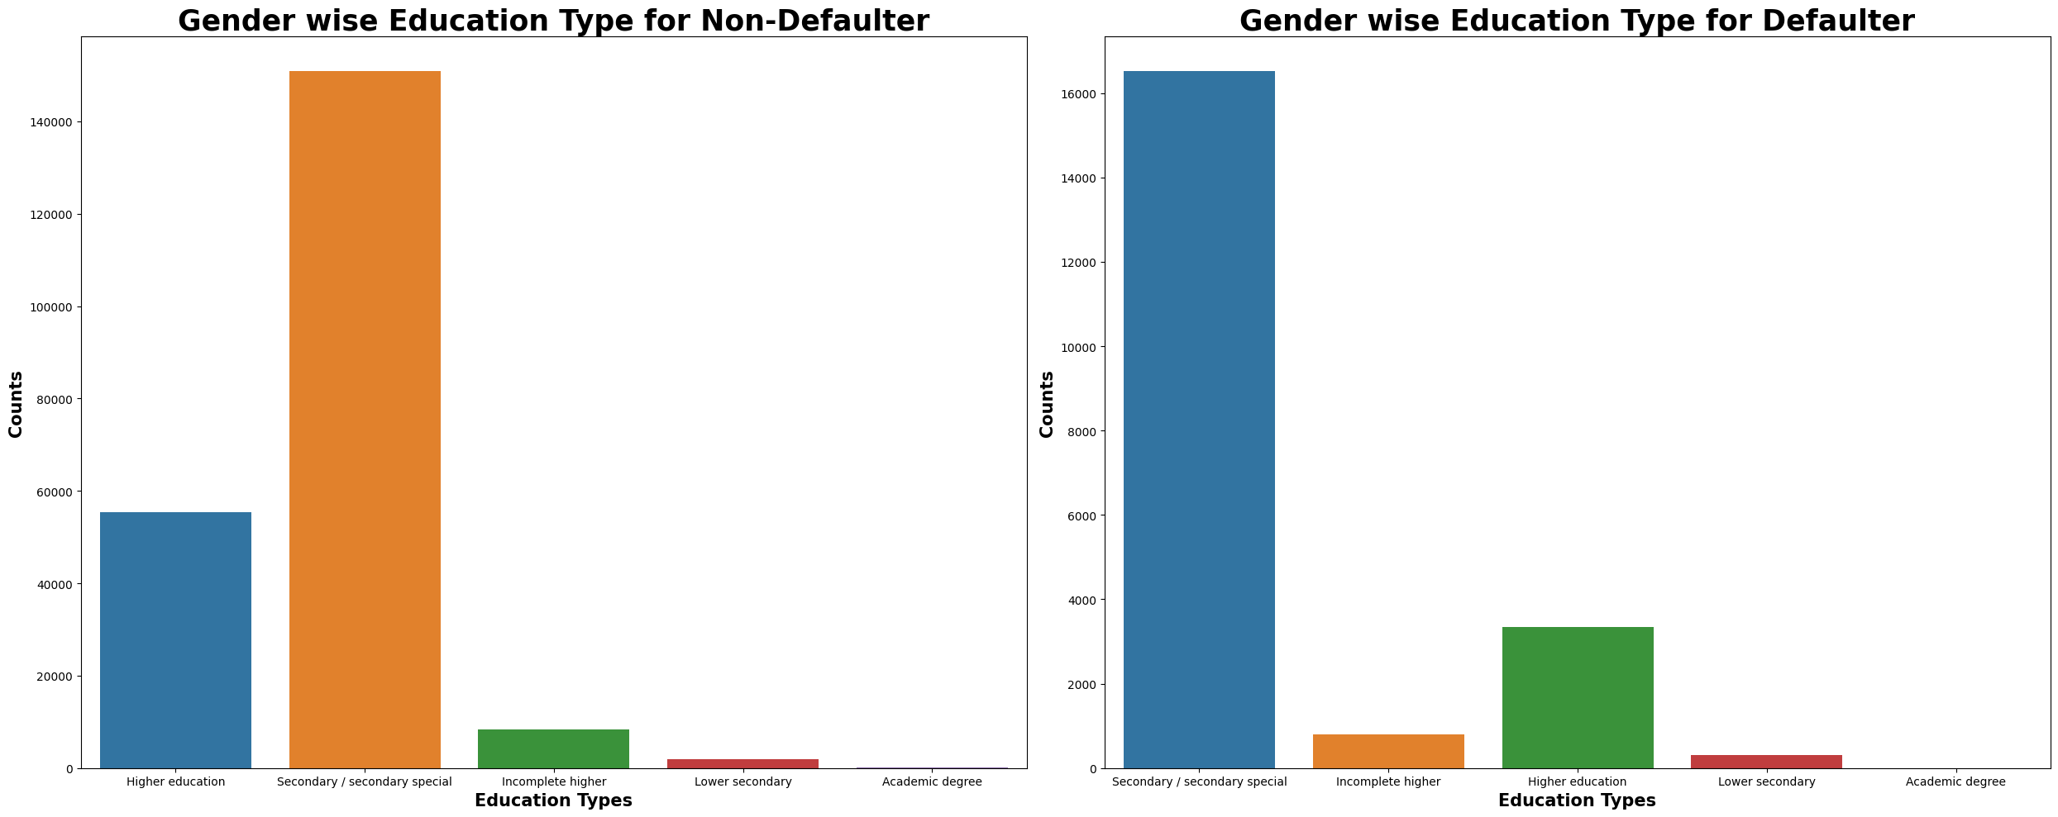
The Large number Secondary Education people who is default in Make payment .
Akash Pandey

Slide 11
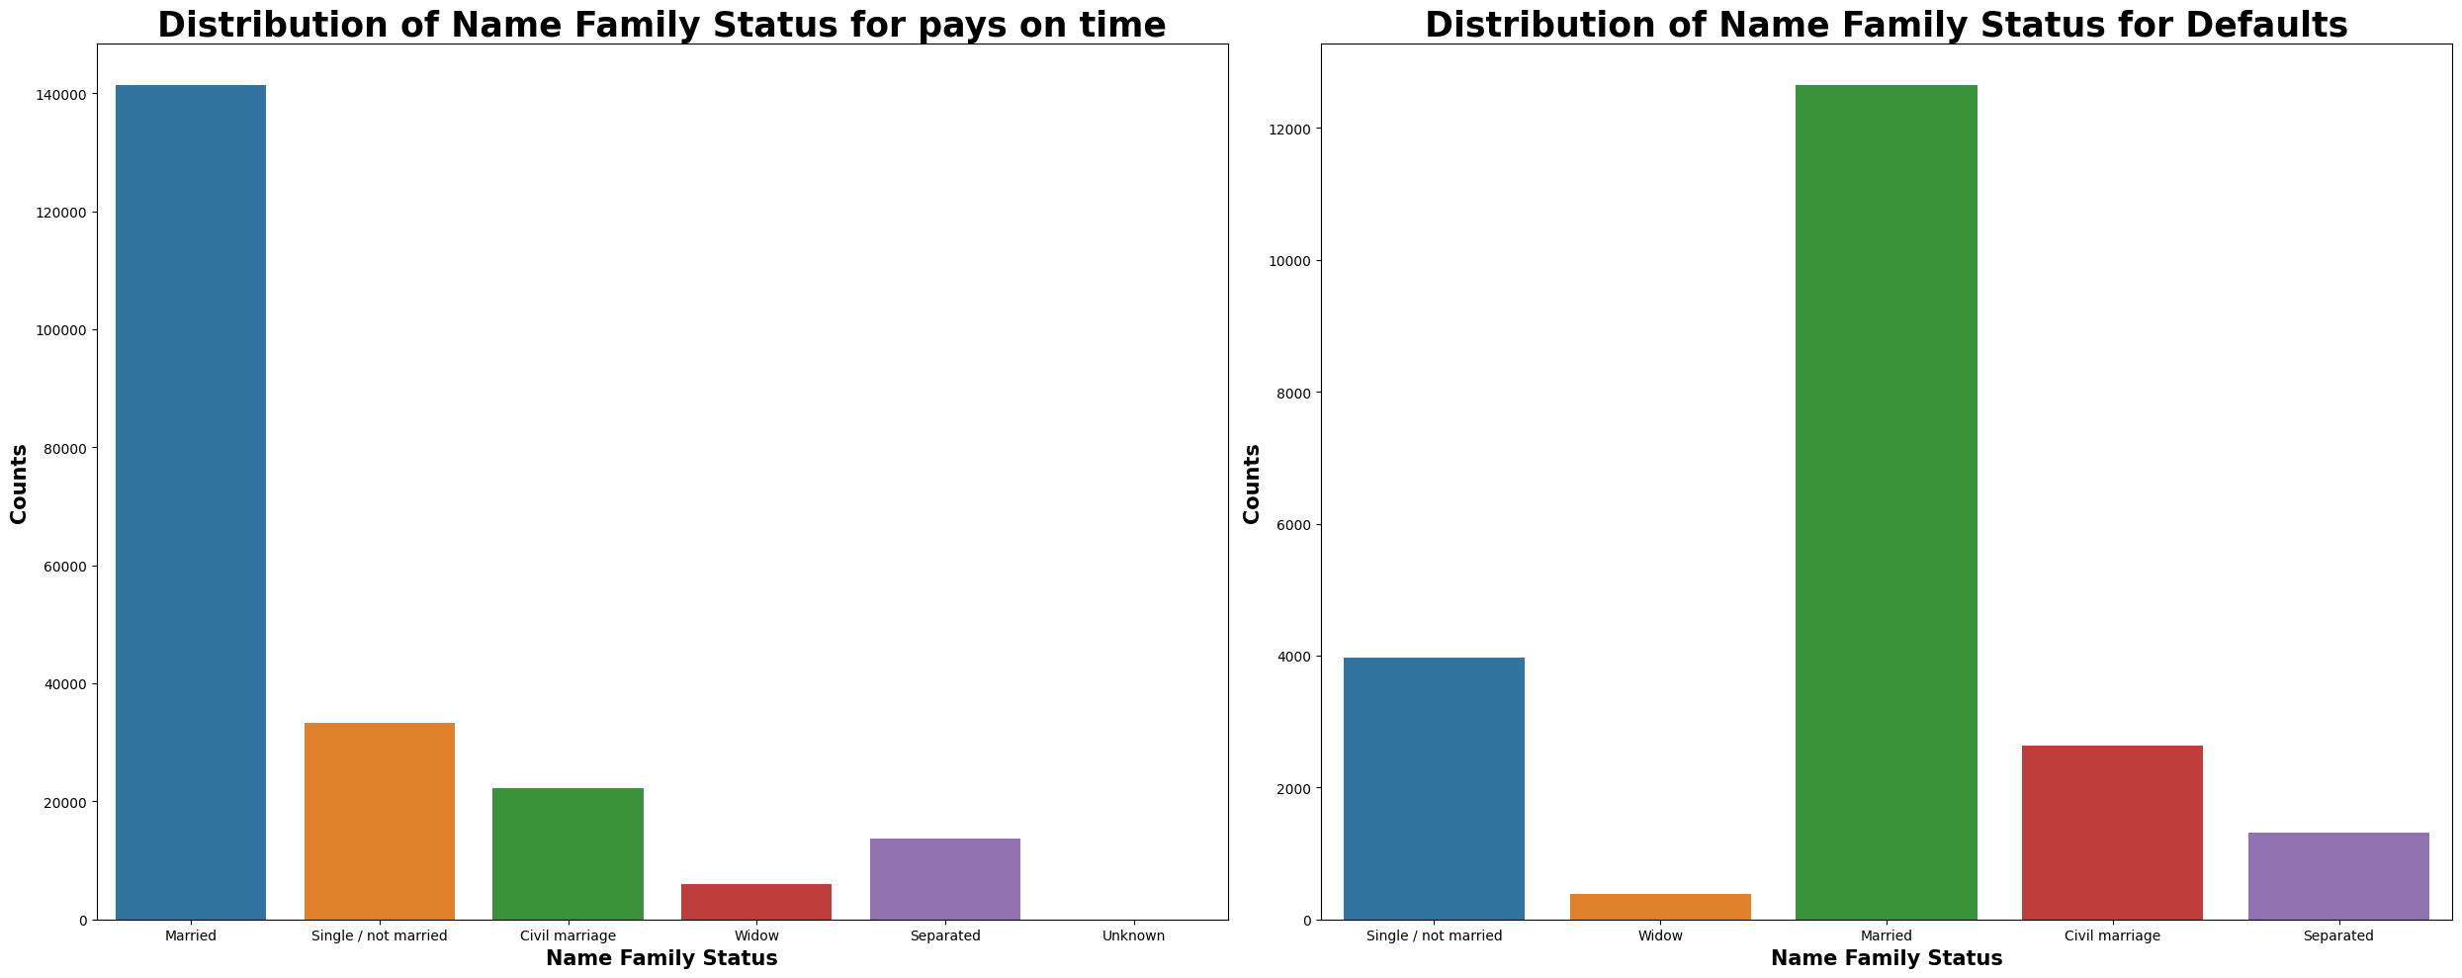
Married person has greater number than others in both conditions.
Akash Pandey

Slide 12
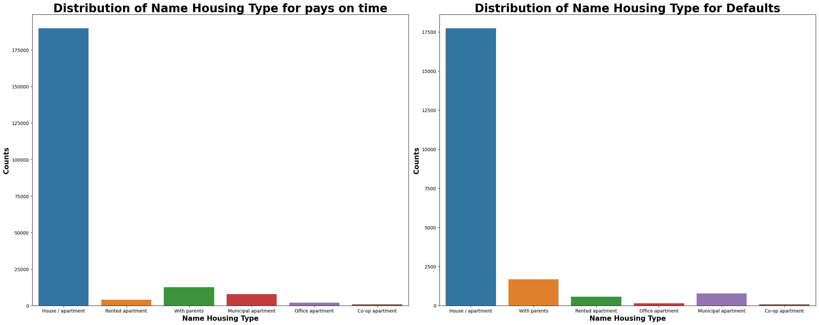
House Apartment has greater number than others in both conditions.
Akash Pandey

Slide 13
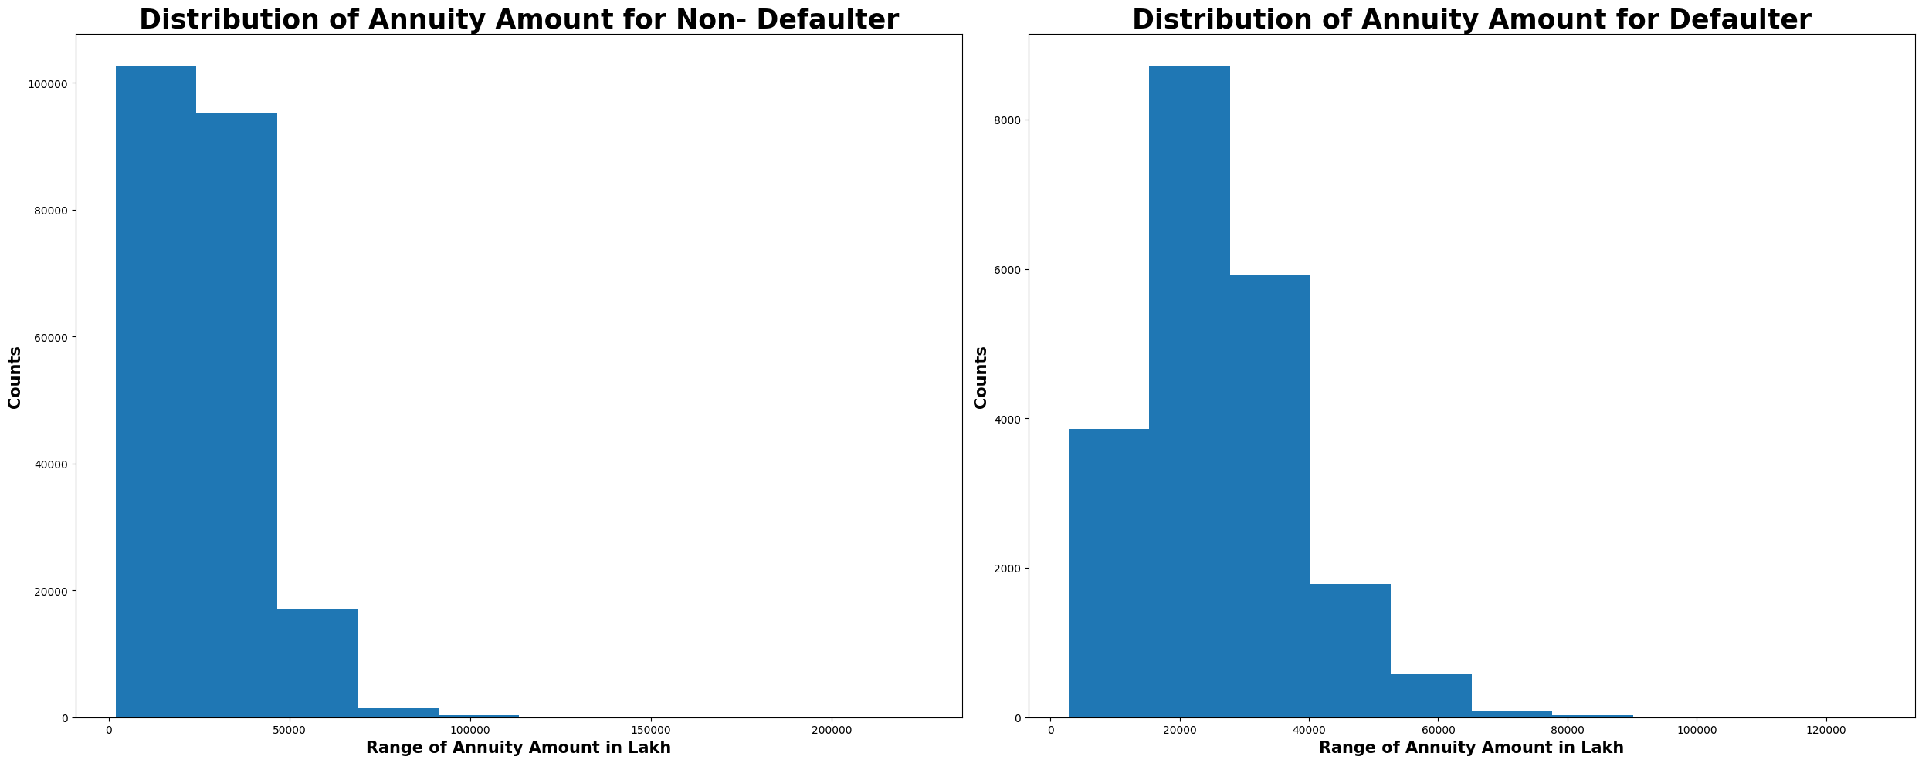
Akash Pandey

Slide 14
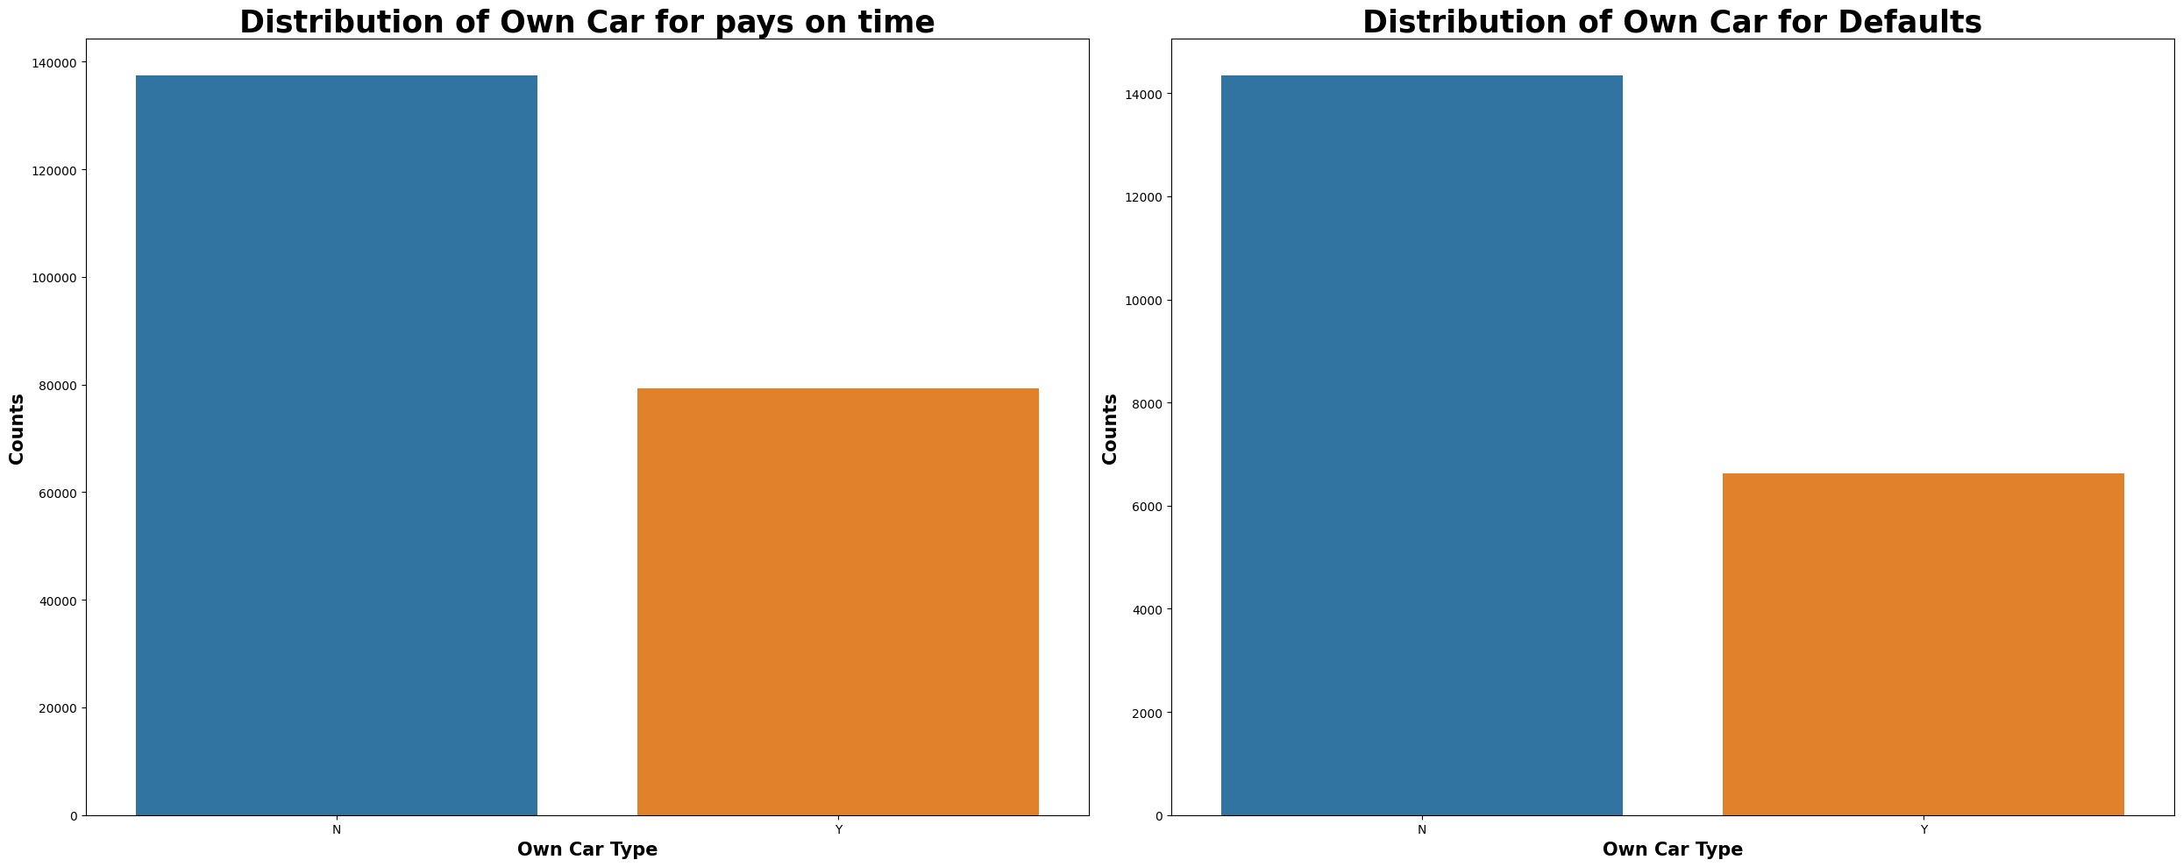
The defaulter number is greater in both conditions Who is not owing the card .
Akash Pandey

Slide 15
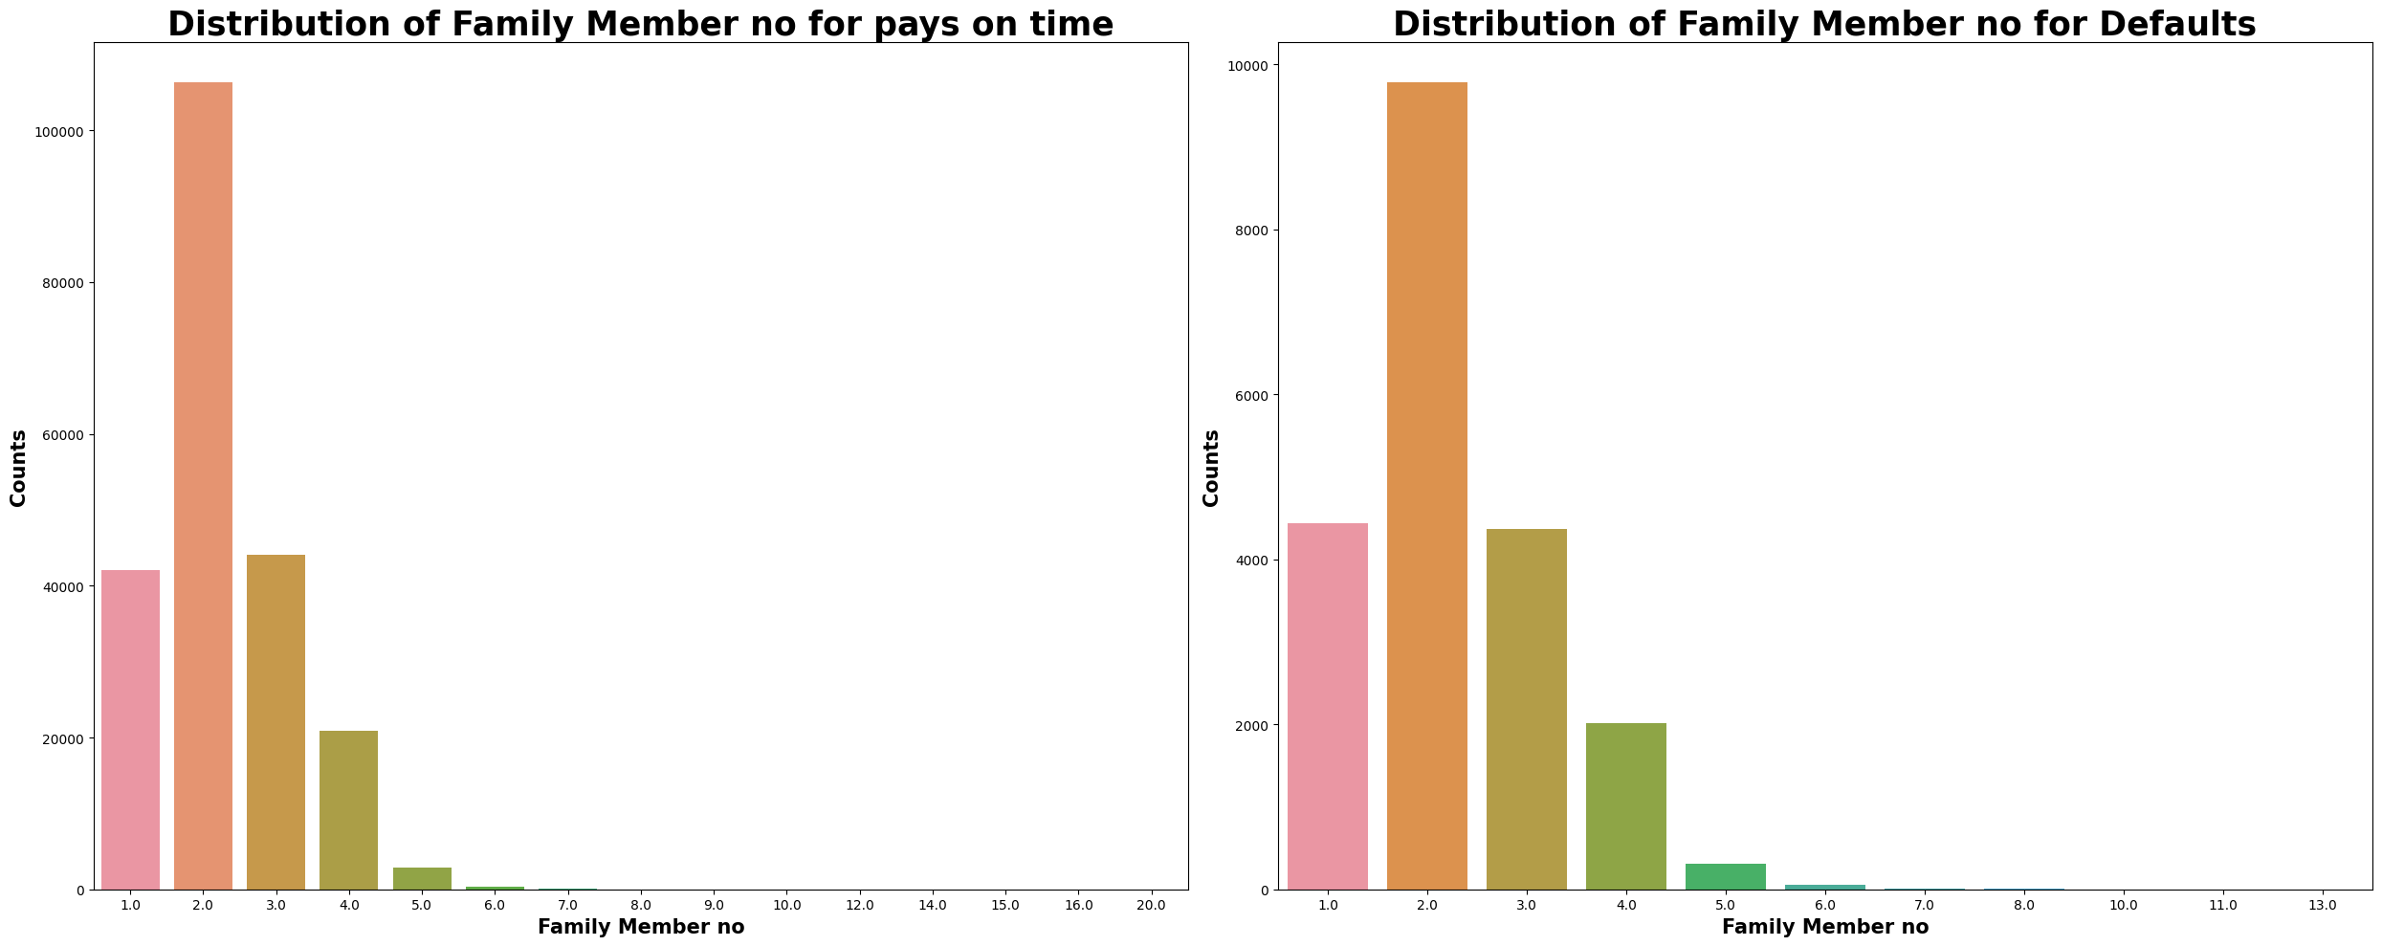
Family member number between 2 – 3 has large number is both conditions.
Akash Pandey

Slide 16
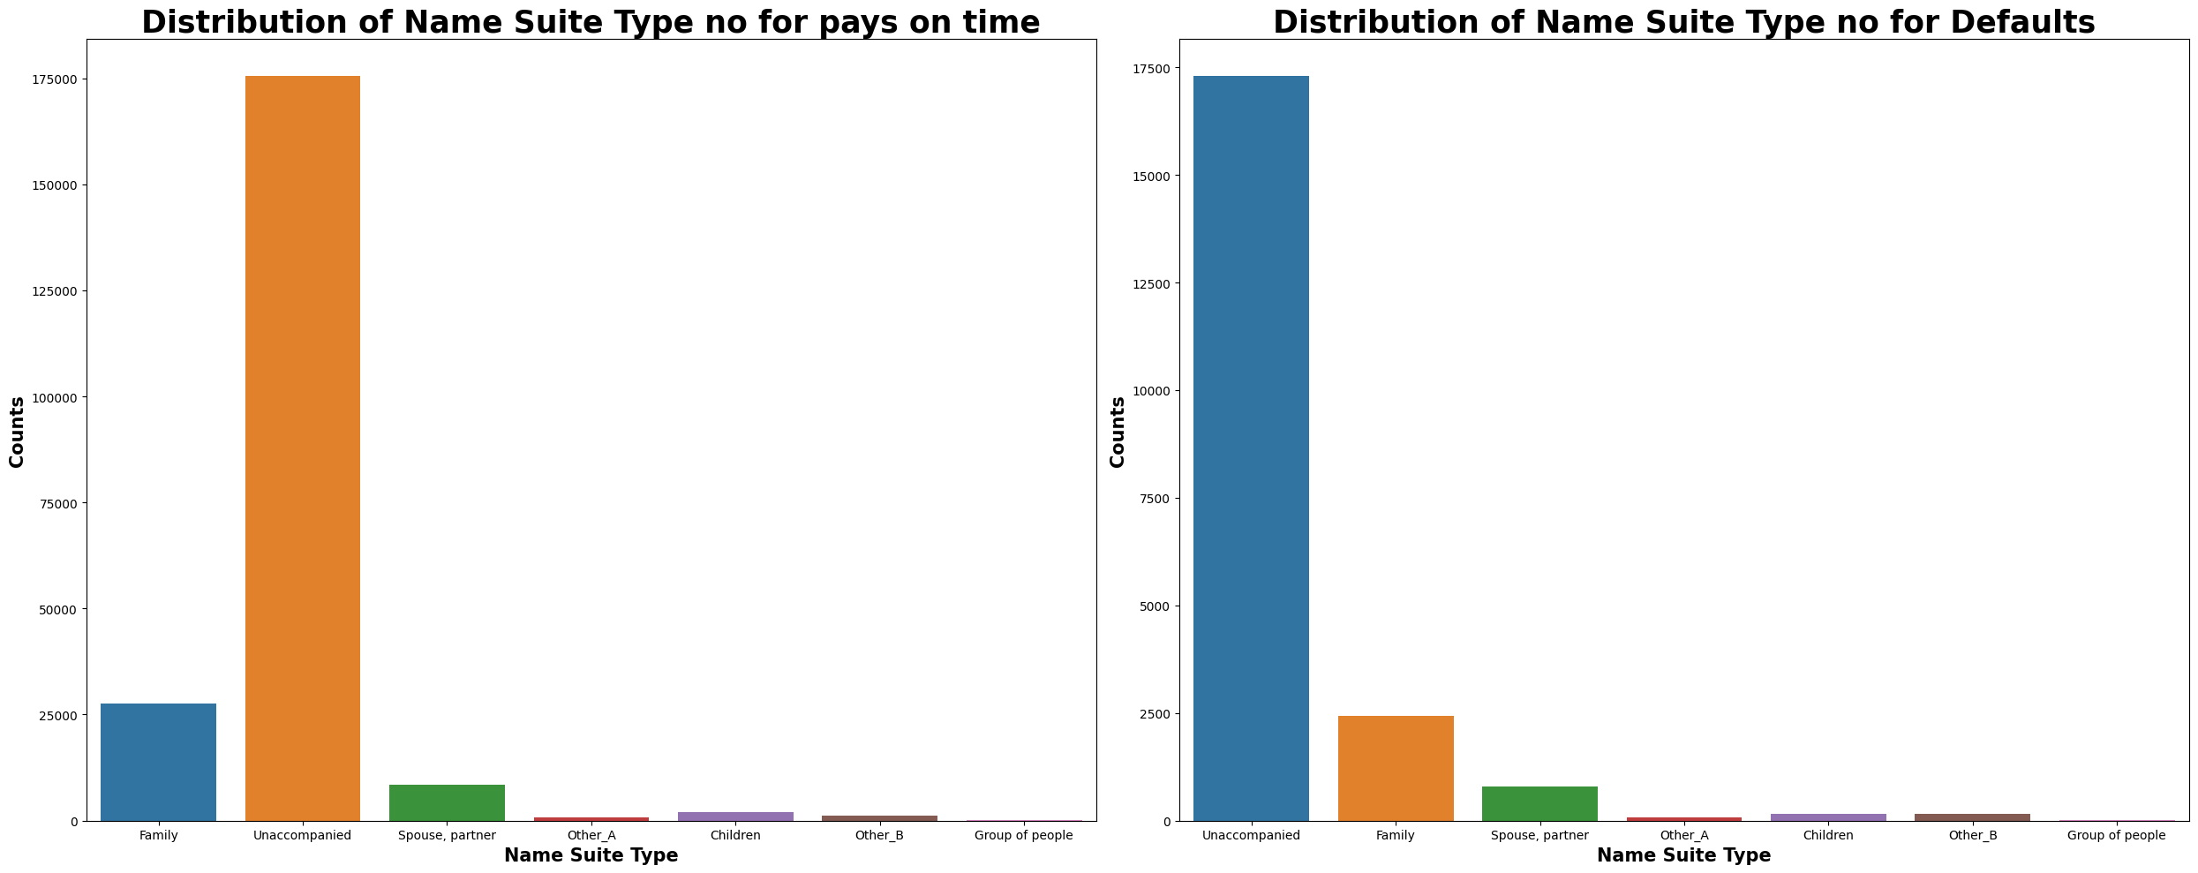
Akash Pandey

Slide 17
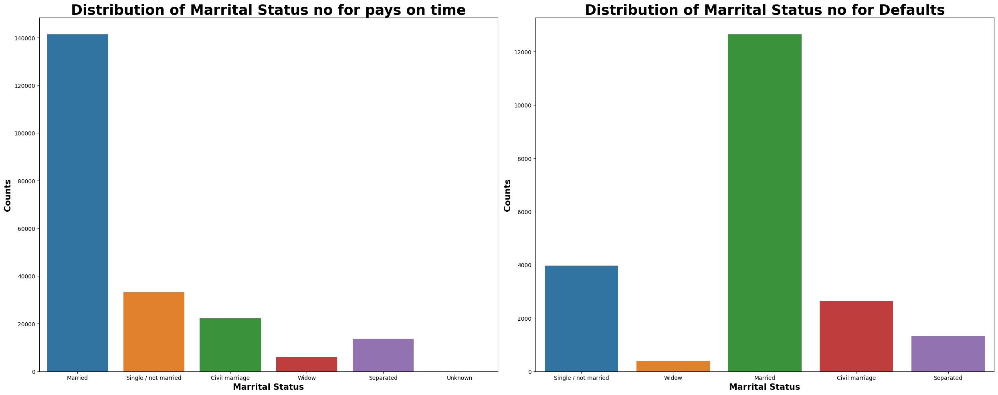
Akash Pandey

Slide 18
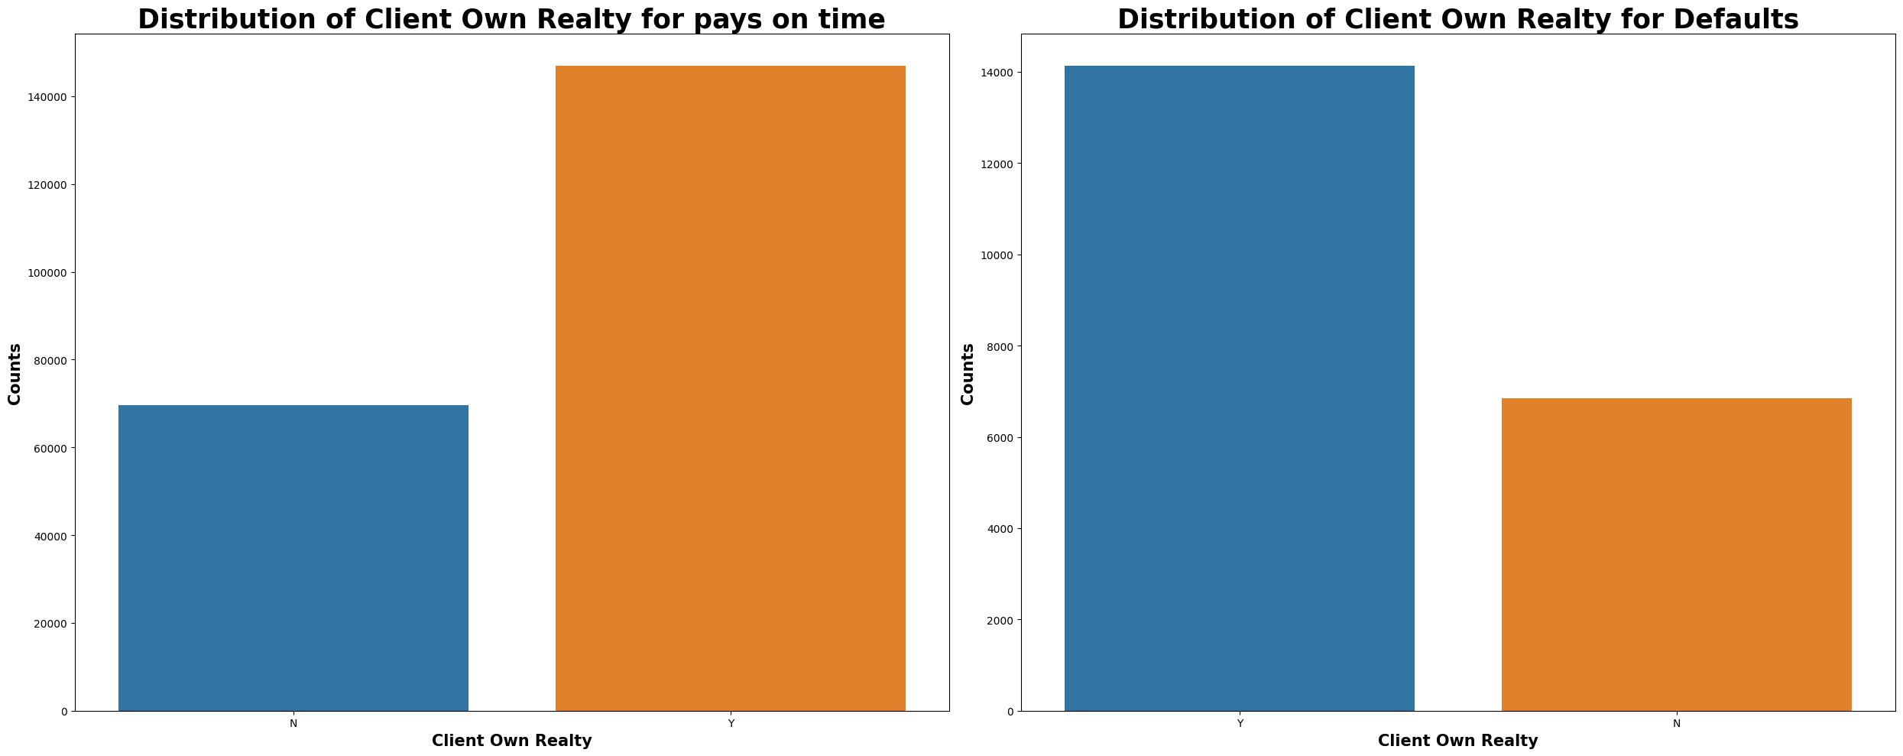
Akash Pandey

Slide 19
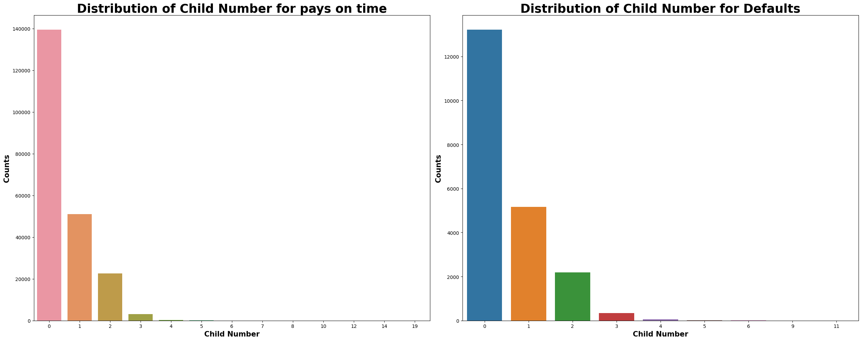
Who has no child or unmarried person number is greater than others is both conditions.
Akash Pandey

Slide 20
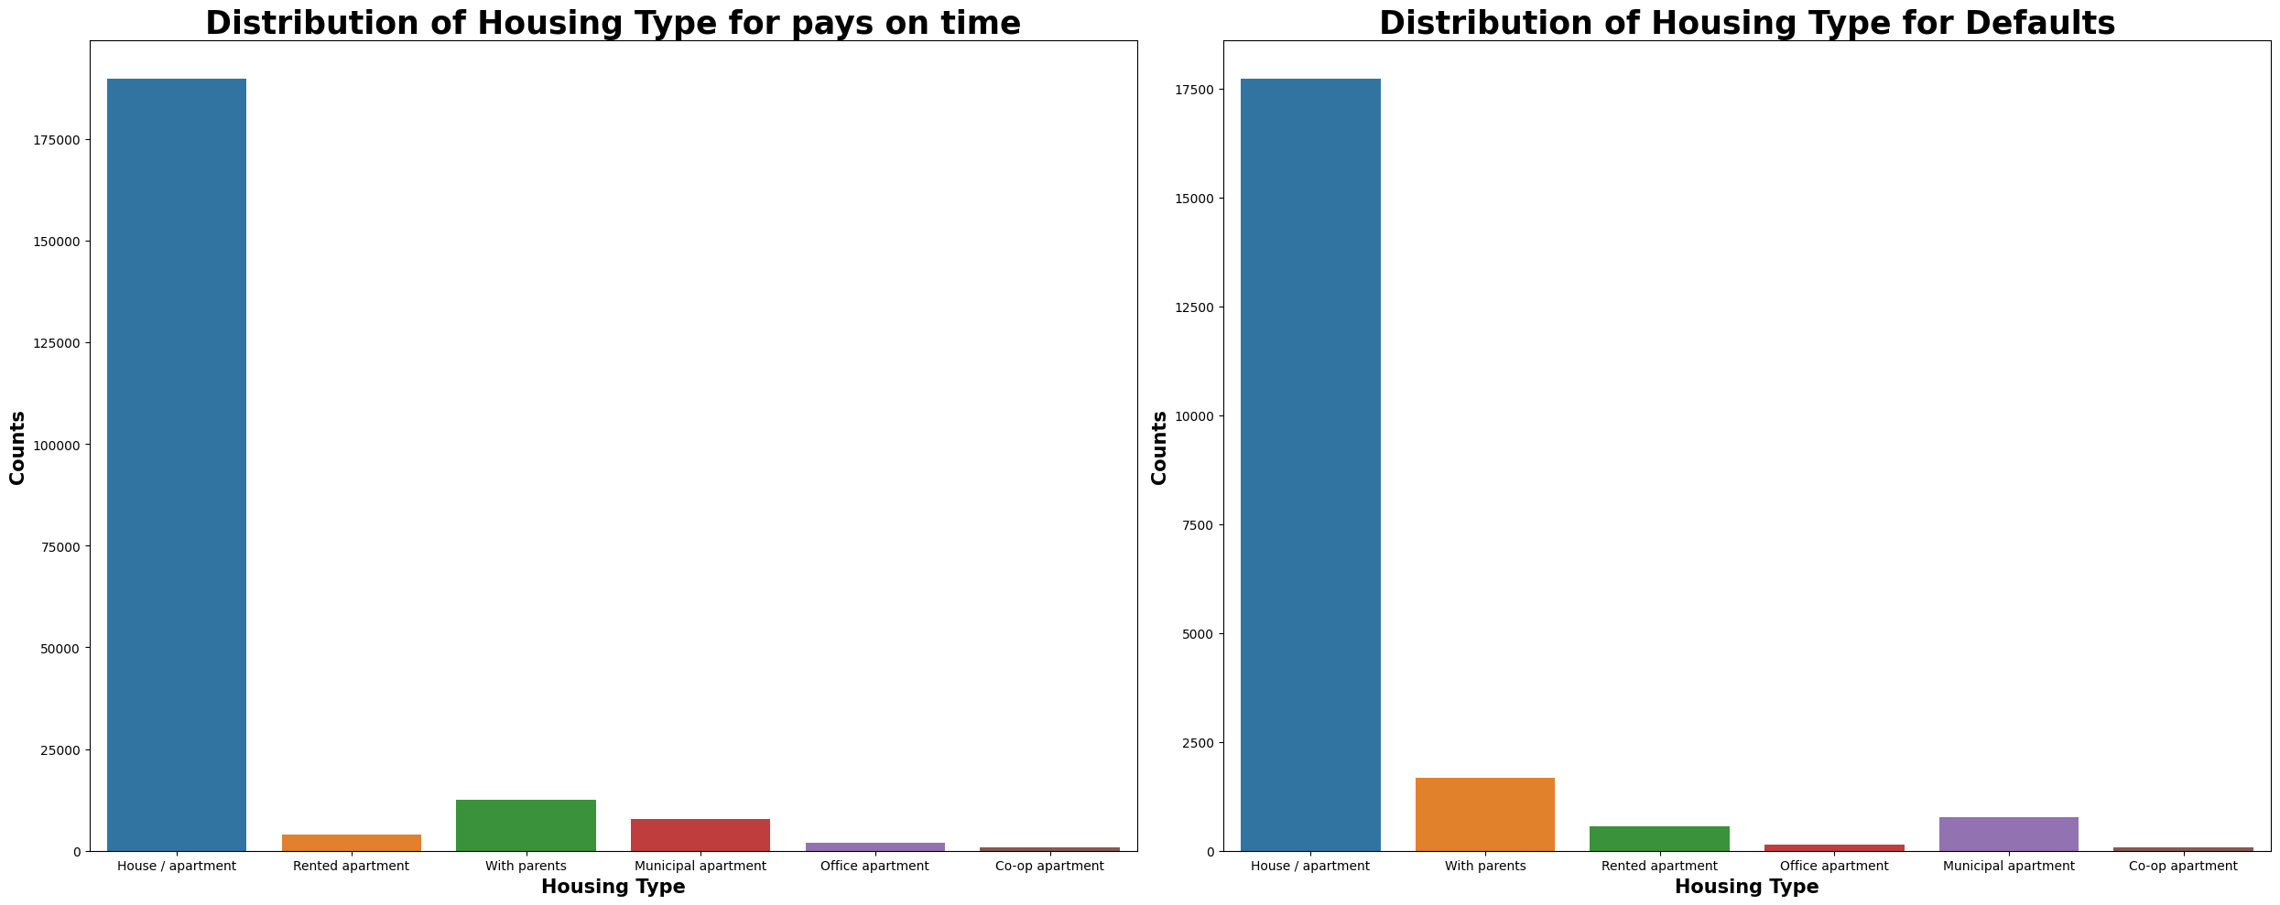
Akash Pandey

